Slide 1

AZURE UPDATE MANAGER PATCH
COMPLIANCE PROGRAMME

Slide 2

Team Members :
NAME | REGISTER ID
BADRI AMRUTHA VEERA VENI | 2400080142
LINGAMANENI MAHESH THEJ | 2400080152

Slide 3
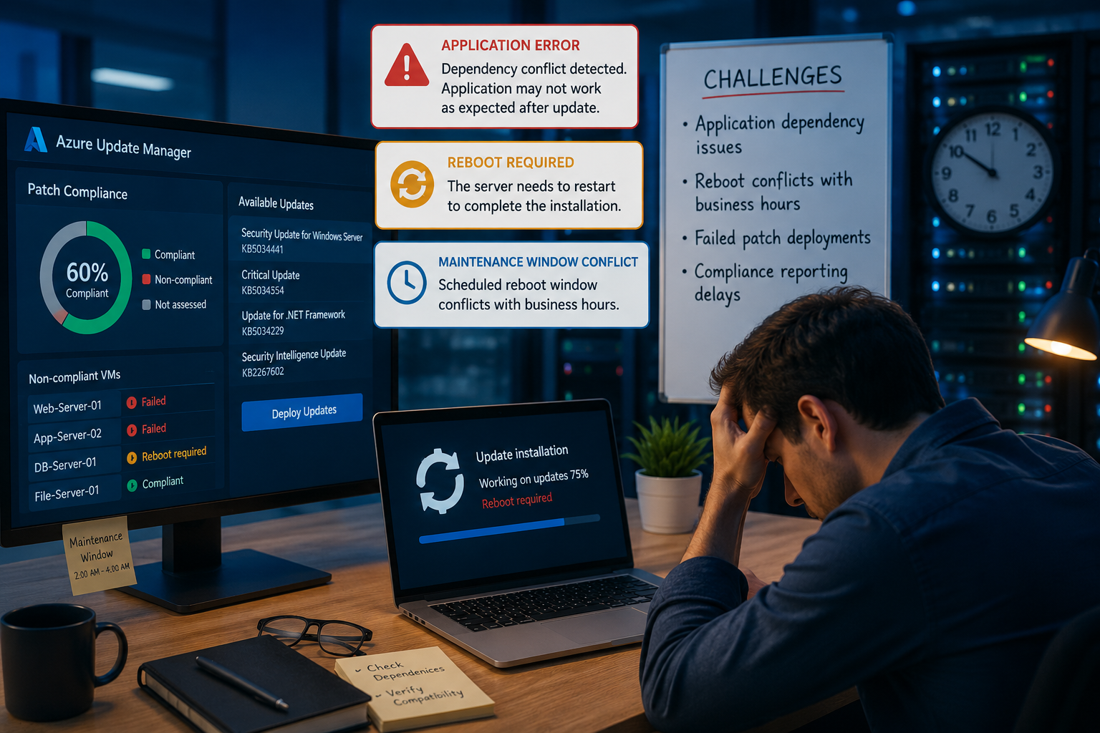
Project Challenges
1. Reboot conflicts with business hours
2.Scheduling and maintenance window conflicts

Slide 4
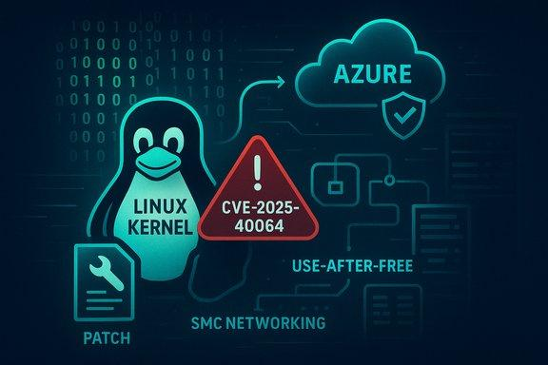
SECURITY VULNERABILITY / PROBLEM STATEMENT
1. Unpatched Security Vulnerabilities
Outdated operating systems and software may contain known security vulnerabilities that can be exploited by attackers.

Slide 5

Azure Update Manager: Modern Patching Strategy
Streamlined, cloud-native approach to patching across Azure,
on-premises, and multi-cloud fleets. Replace brittle, manual processes with an auditable, policy-driven system that scales.

Slide 6

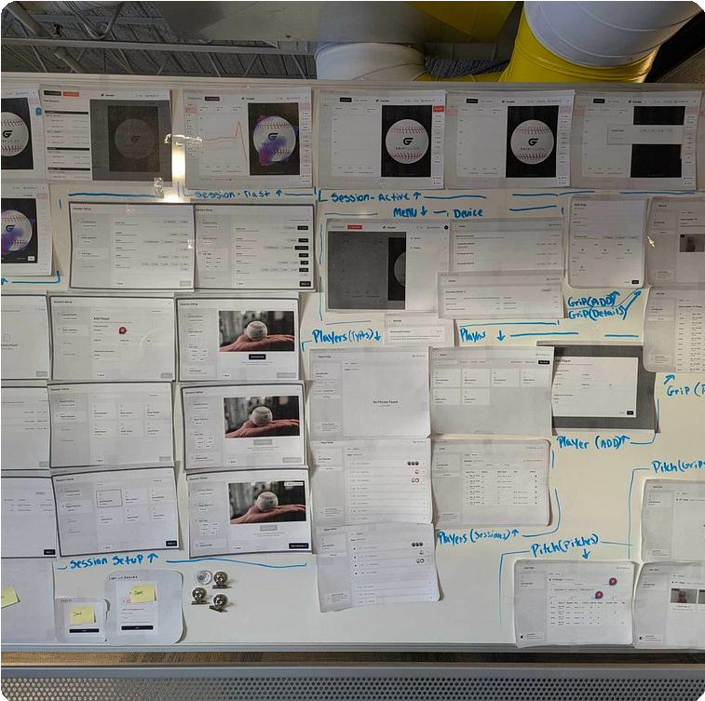
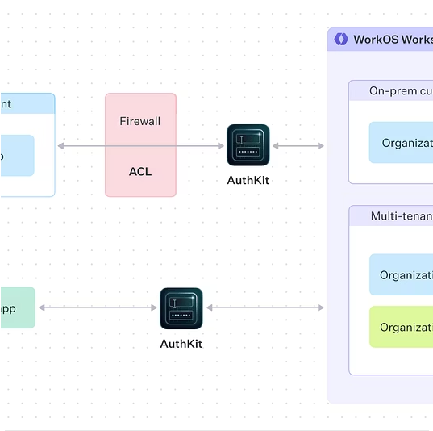
The Legacy Burden:
Why Old Methods Failed
Operational Complexity:
Dependency on Log Analytics + Automation Accounts introduced licensing cost, latency, and fragile runbooks.
Scale Limitations:
Manual, per-server configuration prevented repeatable enterprise-wide patching.
Fragmented Visibility:
Silos across Azure, on-prem, and other
clouds made compliance reporting slow and error prone.

Slide 7
A Paradigm Shift: The Cloud-Native Architecture
Azure Update Manager reimagines patching as an integrated, cloud-first service that minimizes agents and operational overhead while maximizing visibility and governance.
Native Integration
No extra agents required—leverages VM/Connected Machine agent.
Data Locality
Compliance data in Azure Resource Graph — reduce Log Analytics dependence and costs.
Unified Control Plane
Single dashboard for Azure, Arc-enabled servers, and third-party clouds.

Slide 8
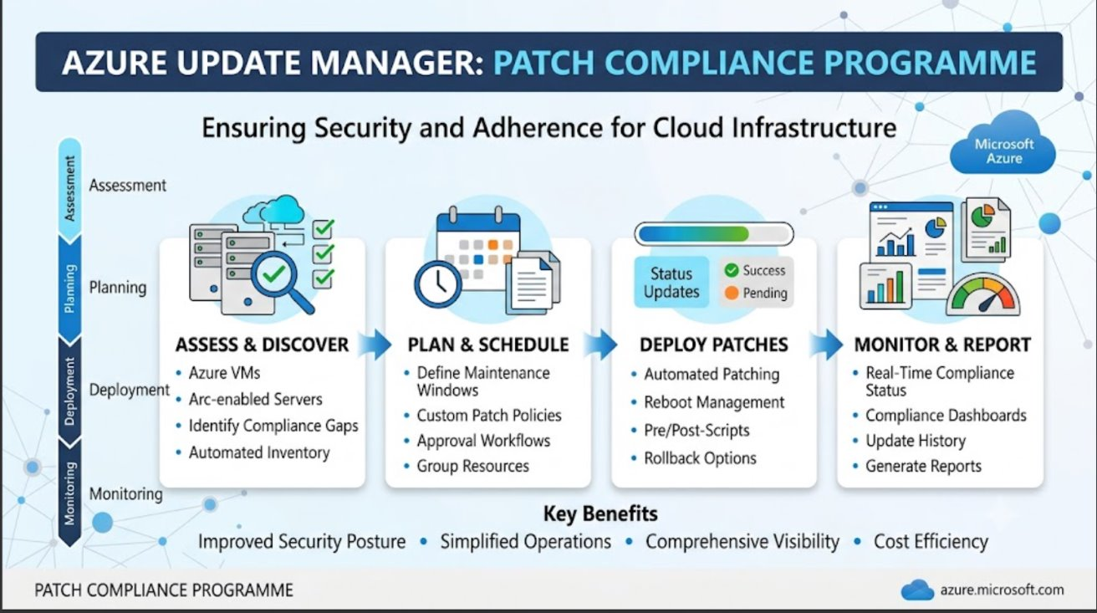

Slide 9
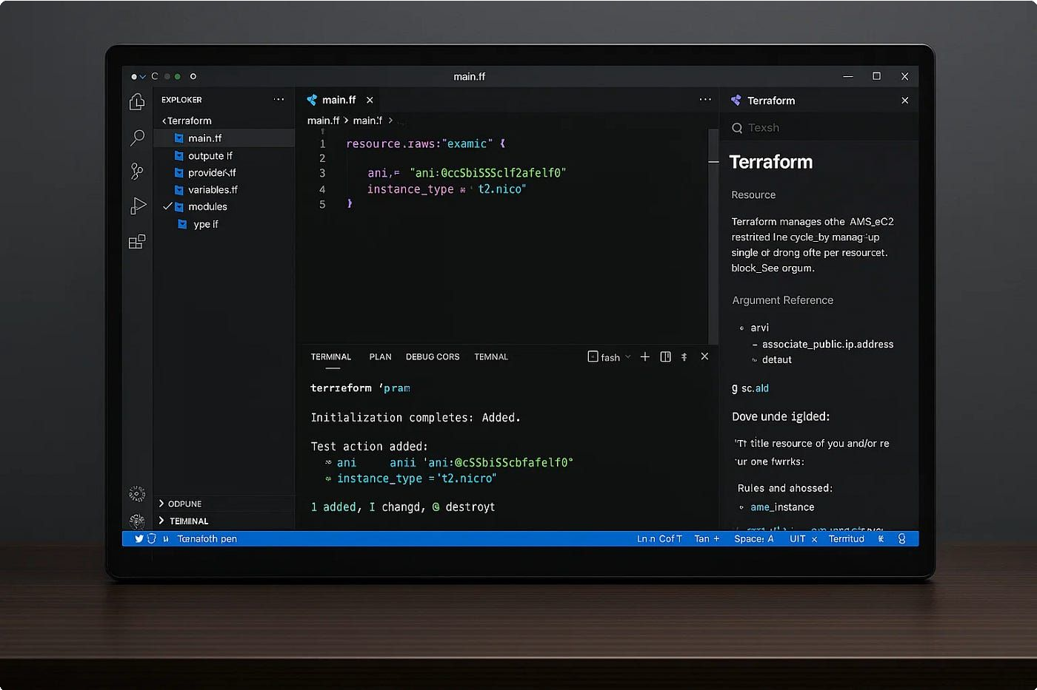
The Foundation:
Azure Arc Connectivity
Arc-enabled servers gain Azure Resource IDs
and appear as native Azure resources
enabling policy, RBAC, and Update Manager control.
Infrastructure as Code (Terraform) automates
onboarding and ensures repeatable, auditable
deployments across environments.
Consistent resource identity for patch targeting
Versioned configuration and rollback
Faster provisioning of compliant fleets

Slide 10
Core Mechanics: Periodic Assessment
Core-1 Core-2
Policy Enforcement:
Azure Policy at resource-group scope ensures machines report missing updates automatically.
Automatic Scanning:
Fleet scans run ~every 24 hours, keeping compliance data current without manual effort.
Core-3
On-Demand Assessment
Trigger immediate, fleet-wide scans for zero-day vulnerabilities or emergency
reviews.

Slide 11
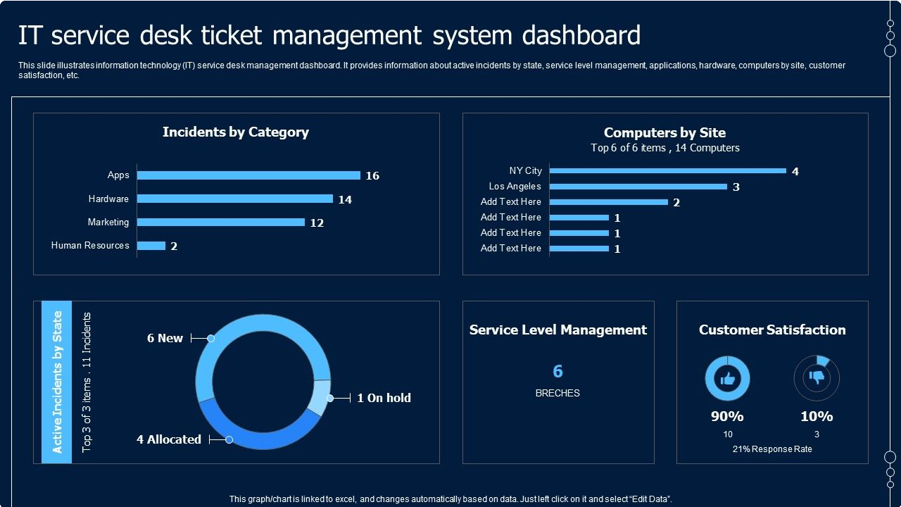
Intelligent Scheduling: Maintenance Configurations
Maintenance Windows defined via Microsoft.Maintenance resources control schedule, duration, and reboot behavior centrally.
Use tags/resource groups for dynamic scoping and auto-enrollment
Exclude specific KBs or packages to block problematic updates
Global safety controls reduce production risk

Slide 12
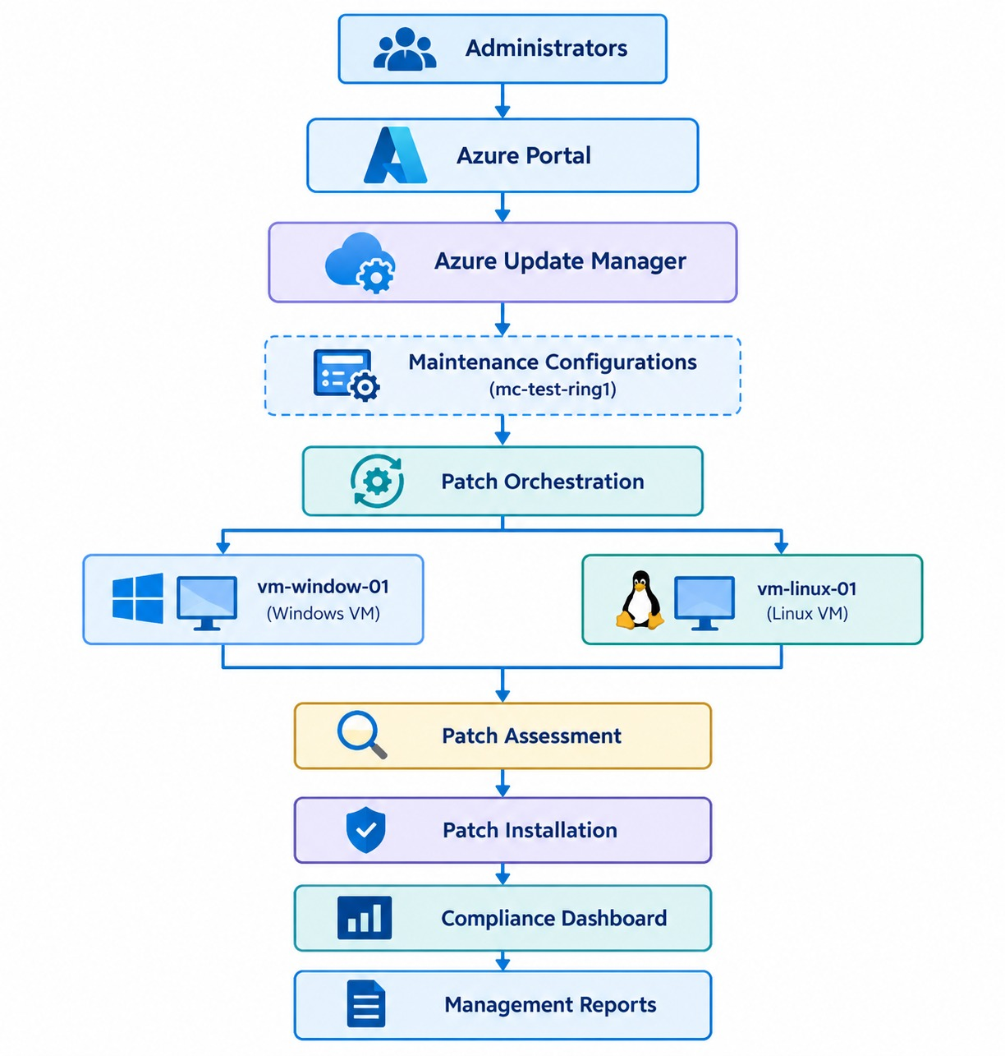

Slide 13

Patch Orchestration Modes
Customer-Managed Schedules:
Platform sets AutomaticByPlatform mode for predictable, scheduled maintenance windows.
Automatic by OS:
OS retains control — Update Manager provides visibility but defers execution to native OS mechanisms.
Manual / Image Default:
Precision patching for mission-critical or legacy workloads that cannot follow standard schedules.

Slide 14
Engineering Success: Real-World Constraints
4-Hour Window Design:
Re-architect patch cadence and batch sizes to complete updates within strict maintenance windows.
Conflict Avoidance:
Align GPO and local registry settings so Update Manager is the authoritative orchestrator.
Safe Migration:
Phase out Automation Accounts with staged transfers, fallback rollbacks, and smoke tests to avoid workload disruption.

Slide 15
The Future: Autonomous Patching Operations
Vision: A self-healing, policy-governed environment where compliance is automatic and measurable.
Audit Now
Review current patch orchestration mode and tag strategy.
1
Enable Policy
Turn on Periodic Assessment via Azure Policy to enforce reporting.
2
Measure & Iterate
Feed JSON artifacts into SIEM/CMDB and refine schedules for minimal disruption.
3

Slide 16
Rollback & Recovery: Handling Failed Patches
Even with the best planning, patch failures can occur. Azure Update Manager provides mechanisms to quickly identify issues and revert changes, minimizing downtime and ensuring system stability.
Proactive Monitoring & Alerting
Integrate with Azure Monitor to trigger alerts on failed patch deployments or critical system errors post-update.
1
Pre-Patch Snapshots & Backups
Leverage automated VM snapshots or restore points before applying patches to enable rapid full system rollbacks.
2
Granular Rollback & Exclusion
Utilize the ability to selectively uninstall problematic updates or exclude specific Knowledge Base articles from future deployments.
3

Slide 17
Monitoring & Alerting: Real-Time Visibility
Gain instant, actionable insight into your patching operations with integrated monitoring and proactive alerting across your entire fleet.
Real-Time Compliance Dashboards
Centralized view of patch status across Azure and hybrid machines.
Detailed insights per machine for missing updates and reboot status.
Dynamic fleet health queries using Azure Resource Graph.
Proactive Anomaly Detection
Configurable alerts for patching failures, non-compliance, and missed schedules.
Notifications via Azure Monitor, Action Groups (email, SMS, webhooks).
Early warning for critical security vulnerabilities and system health deviations.

Slide 18



Cost Optimization: Reducing Operational Overhead
Azure Update Manager delivers substantial cost savings by streamlining operations and leveraging cloud-native capabilities, shifting from reactive spending to proactive efficiency.
Direct Cost Savings
Eliminate dedicated Automation Accounts and unnecessary Log Analytics workspaces, directly reducing licensing and infrastructure
Enhanced Operational Efficiency
Automate patching across diverse fleets, lowering labor costs and reallocating IT staff to higher-value strategic projects.
Optimized Resource Utilization
Minimize server downtime and improve performance through intelligent, policy-driven scheduling

Slide 19
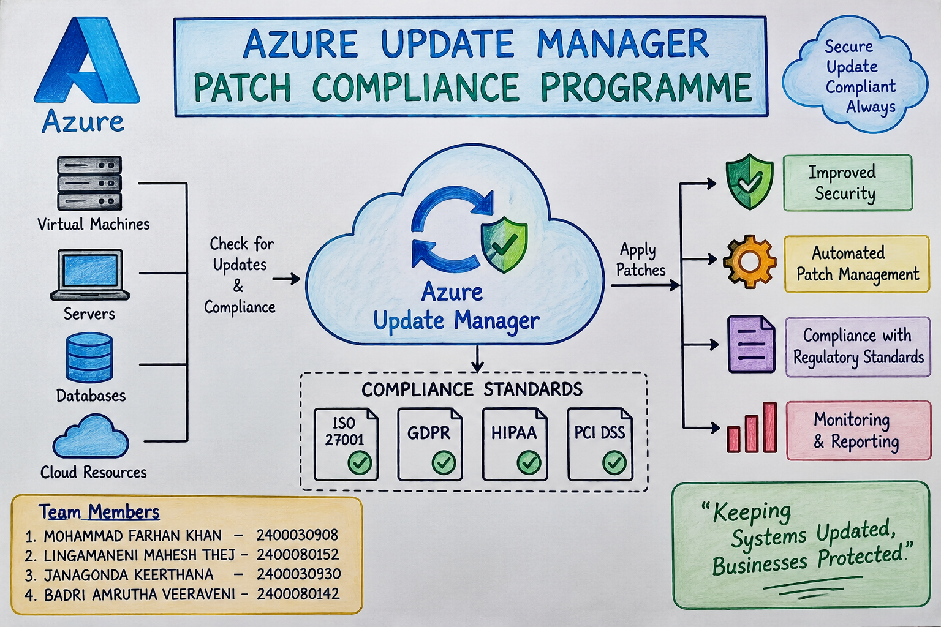
Security & Compliance: Meeting Regulatory Requirements
Azure Update Manager isn't just about efficiency; it's a critical tool for demonstrating continuous compliance and strengthening your security posture against evolving threats.

Slide 20
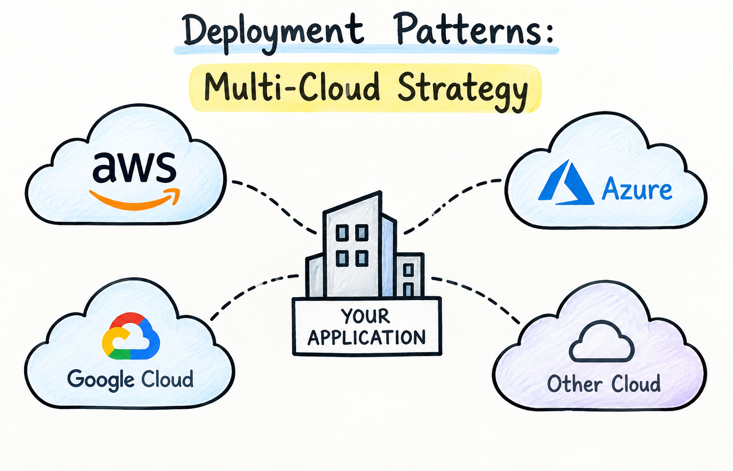
Deployment Patterns: Multi-Cloud Strategy
Extend the power of Azure Update Manager beyond Azure to create a truly unified patching strategy across your entire hybrid and multi-cloud footprint.
Azure Arc for Any Cloud
Onboard virtual and physical servers from AWS, GCP, or private clouds via Azure Arc to bring them under central management.
Consistent Policy Enforcement
Apply uniform patching policies and maintenance schedules across all connected machines, regardless of their hosting environment.
Unified Visibility & Reporting
Gain a single pane of glass for patch compliance and status across your entire fleet, simplifying auditing and risk management.

Slide 21
Project Outcome
The Azure Update Manager Patch Compliance Programme provides a centralized and automated approach to managing system updates across cloud and hybrid environments. It helps organizations identify missing patches, maintain compliance with security standards, and reduce security risks caused by outdated software.
By automating patch assessment, deployment, monitoring, and reporting, the solution improves security, system reliability, operational efficiency, and regulatory compliance. Overall,
Azure Update Manager helps organizations maintain secure and compliant IT infrastructure with less manual effort.

Slide 22
